Slide 1
Google Classroom for Students and Parents
Presented by Mr. Tyler – Director of Technology

Slide 2
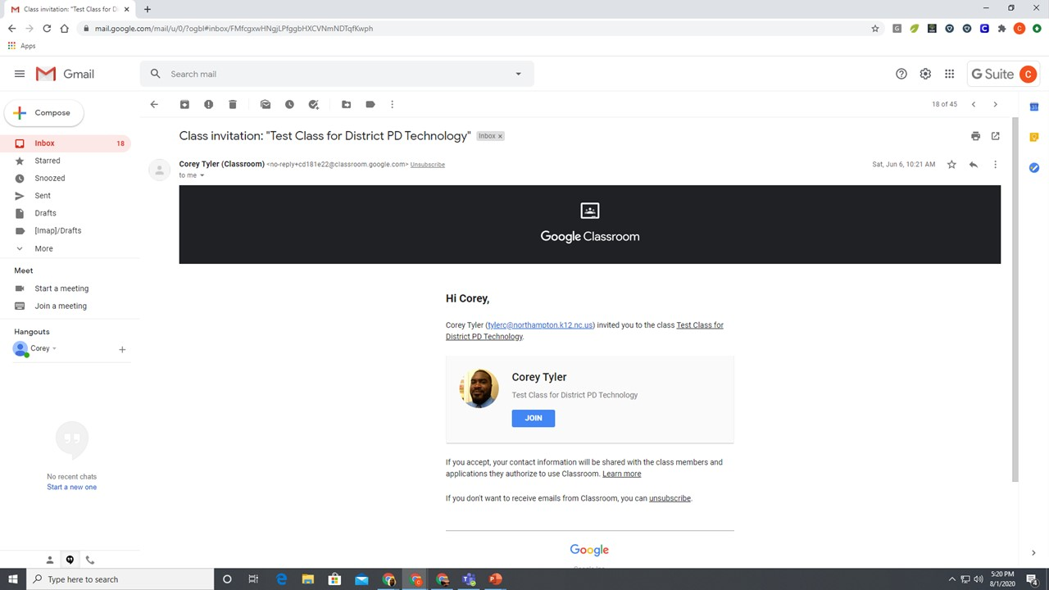

Slide 21
Thank you for looking if you have any questions or if you need further assistance you can always email me at
tylerc@northampton.k12.nc.us or you can call our Help Desk at 252-534-0222 during business hours. Good Luck this year!

